Slide 1
Cultural school of thought

Slide 2
Theory of Culture
Early Evolutionism: E.B Tylor (1832-1917) Culture evolved from simple to complex. All societies passed though three stages savagery, barbarism and civilization. Different contemporary societies were at different stages of evolution.
Two 19th Century anthropologists whose writings exemplified the theory that culture generally evolves uniformly and progressively were E.B Tylor (1832-1917) and Lewis Henry Morgan (1818-1889)
Culture evolved from simple to complex that all societies passed through basic stages of development
Savagery- cruel and violent behaviour
Barbarism- absence of culture and civilization
Civilization- the stage of human social and cultural development and organization that is considered most advanced.

Slide 3
To account for cultural variation, Tylor and other early evolutionists postulated that different contemporary societies were at different stages of evolution.
According to this view, the “simpler” peoples of the day had not yet reached “higher” stages. Thus, simpler contemporary societies were thought to resemble ancient societies.
In more advanced societies one could see proof of cultural evolution through the presence of what Tylor called survivals – traces of earlier customs that survive in present-day cultures. The making of pottery is an example of a survival in the sense used by Tylor.
Earlier peoples made their cooking pots out of clay; today we generally make them out of metal because it is more durable, but we still prefer dishes made of clay.

Slide 4
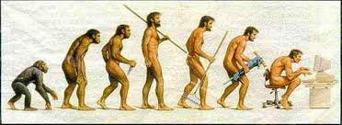

Slide 5
Diffusionism: Two main schools with a Diffusionist viewpoint were the British and German-Australian. G. E Smith, W.J Perry and WHR River stated most aspects of higher civilization were emerged in Egypt. It then got diffused through the world through contact with Egypytians.
Geographical culture centre traits were first developed and from which they then diffused outward.

Slide 6
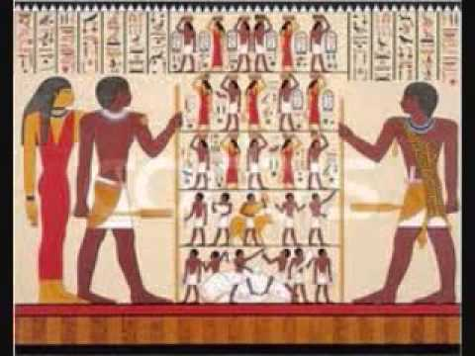

Slide 7
Diffusionism as an anthropological school of thought, was an attempt to understand the distribution of culture in terms of the origin of culture traits and their spread from one society to another.
Versions of diffusionist thought included the conviction that all cultures originated from one culture center (heliocentric diffusion); the more reasonable view that cultures originated from a limited number of culture centers (culture circles); and finally the notion that each society is influenced by others but that the process of diffusion is both contingent and arbitrary
Studying these very diverse cultures stimulated an interest in discerning how humans progressed from primeval conditions to “superior” states.
Some Social Evolutionists, on the other hand, proposed that the “psychic unity of mankind” meant that since all human beings share the same psychological traits, they are all equally likely to innovate

Slide 8
Functionalism: Functionalism in social science looks for part (function) some aspects of culture or social life plays in maintaining a cultural system.
British anthropologists Bronislaw Malinowski (1884-1942): All cultural traits serve needs of individuals in a society. The function of a culture trait is its ability to satisfy basic needs such as nutrition, bodily comfort, reproduction, growth, safety
AR Radcliff Brown (1881-1955): Various aspects of social behaviour maintain a society’s social structure. The total network of existing social relationships in a society.

Slide 9
How function of society work as per functionalism
https://www.khanacademy.org/test-prep/mcat/society-and-culture/social-structures/v/functionalism

Slide 10
Structuralism: Claude Levi-strauss leading proponent of an approach to cultural analysis called structuralism. Origin of elements of society system such as art, rituals, pattern of daily life, as surface representation of the underlying structure of the human mind
According to structural theory in anthropology and social anthropology, meaning is produced and reproduced within a culture through various practices, phenomena and activities which serve as systems of signification. A structuralist studies activities as diverse as food preparation and serving rituals, religious rites, games, literary and non-literary texts, and other forms of entertainment to discover the deep structures by which meaning is produced and reproduced within a culture.
Cultural ecology: Julian Steward advocated study of cultural ecology. Analysis of the relationship between a culture and its environment
Political economy: external forces explain the way a society changes and adapts. But it is not the natural environment, or the social environment in general, that is central to the approach of political economy.

Slide 11
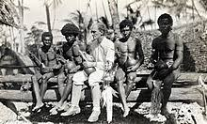
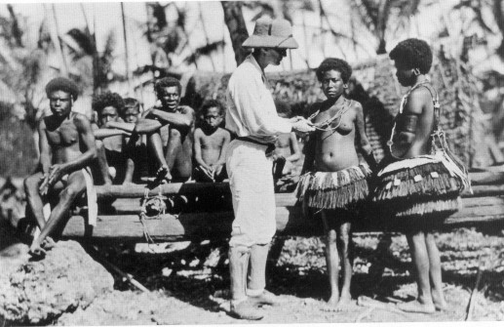
Studying culture: Malinowski with Trobriand Islanders

